Slide 1





超导量子计算和量子模拟
陈远珍
南方科技大学物理系
暨量子科学与工程研究院

Slide 2

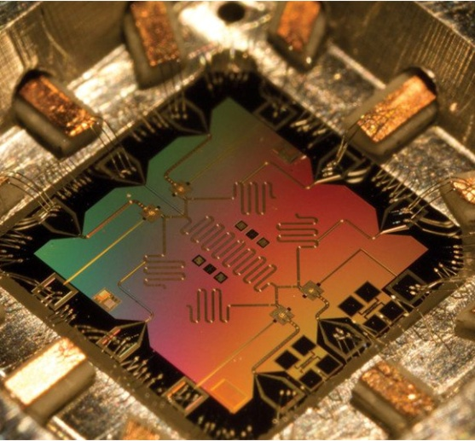
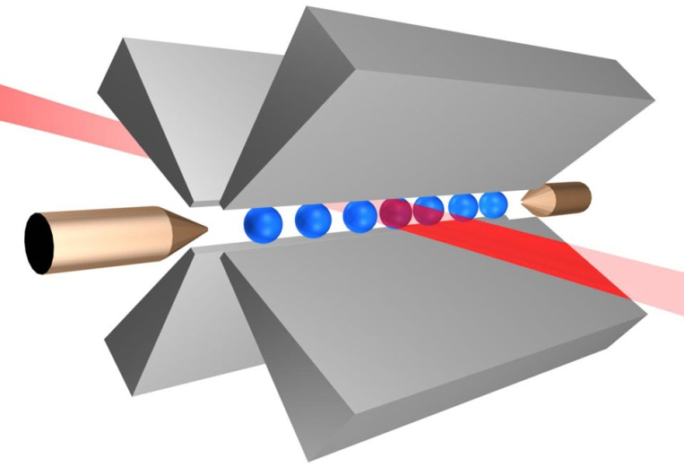
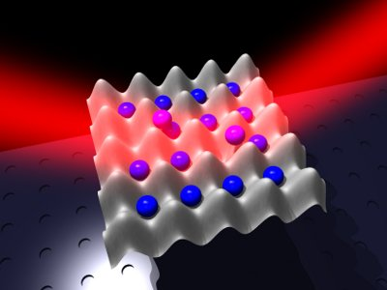
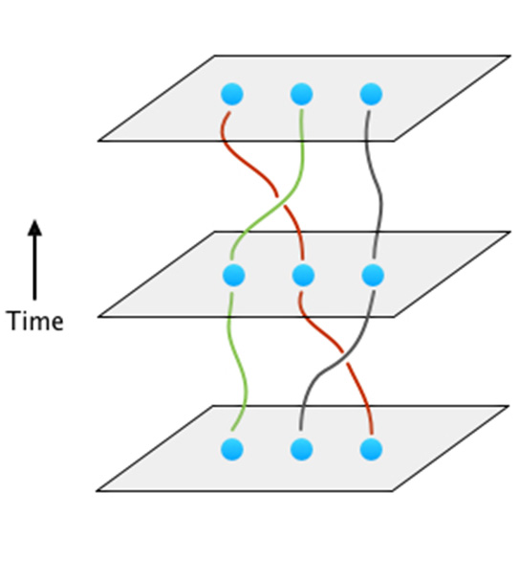
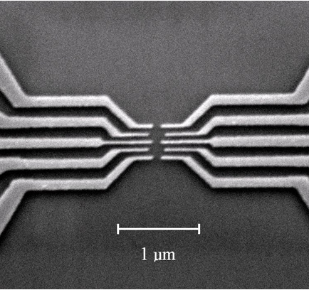
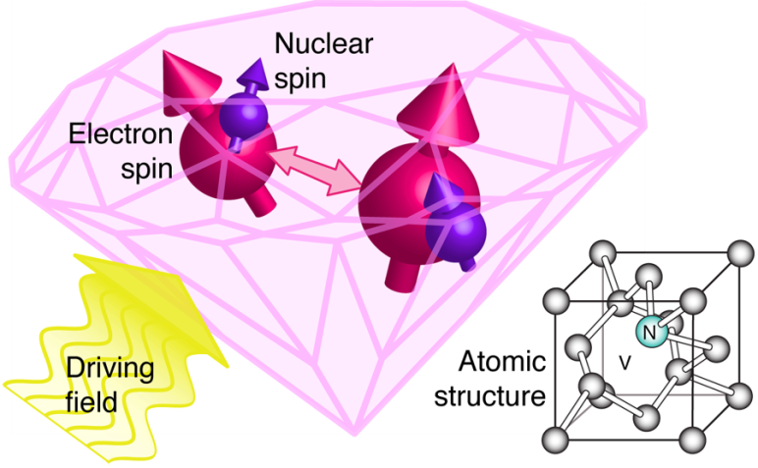
量子计算的代表性技术路线
超导量子芯片
离子阱
超冷原子
半导体量子点
自旋磁共振
拓扑量子态

Slide 3
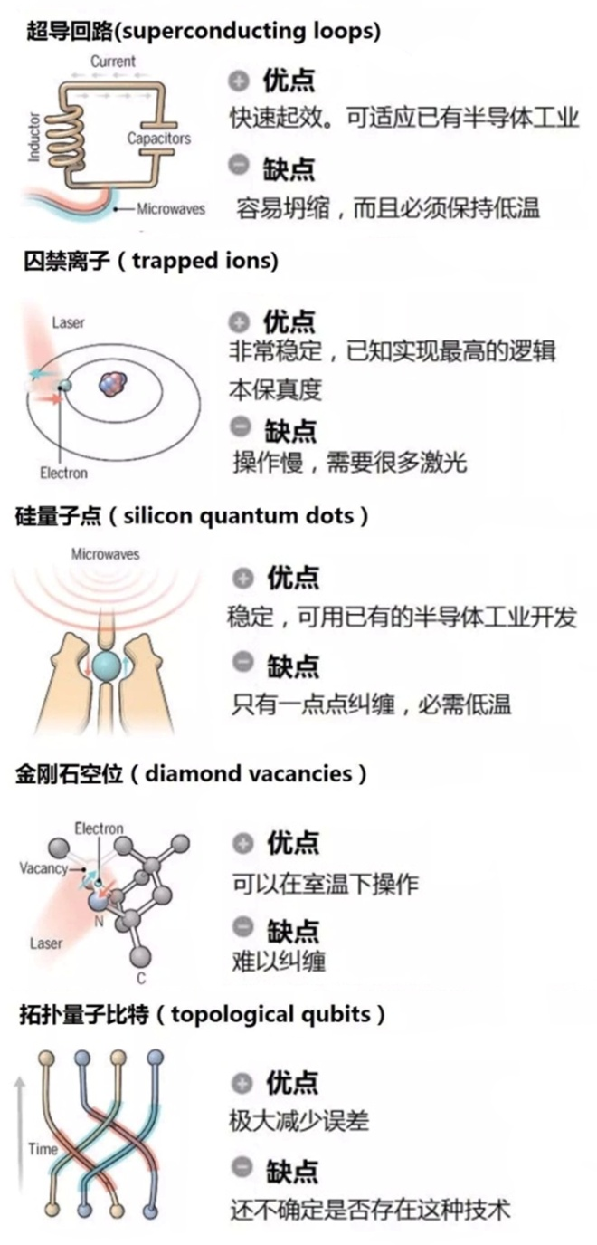







量子计算的代表性技术路线
ionQ
Quantum Diamond
Technologies

Slide 4
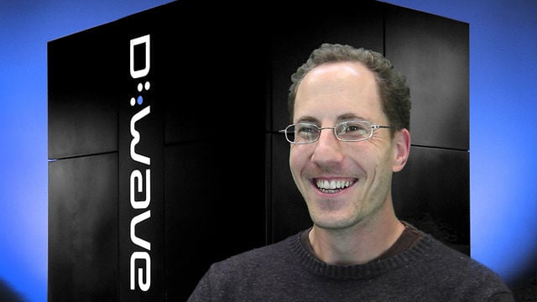
D-Wave的超导“量子”计算机
2008年D-Wave公司宣布他们将展示一个具有16个bit的量子计算机。目前他们已经发布了包含超过2000个超导量子比特的 D-Wave量子计算机。

Slide 5
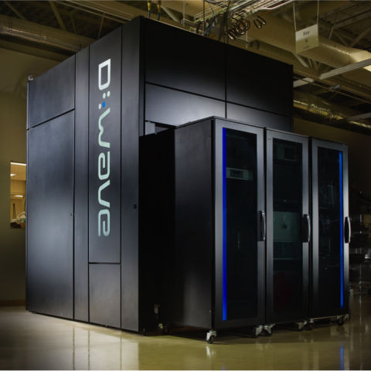
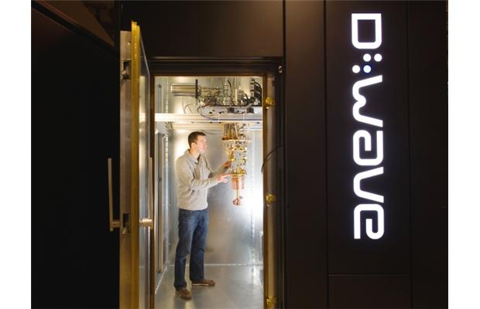
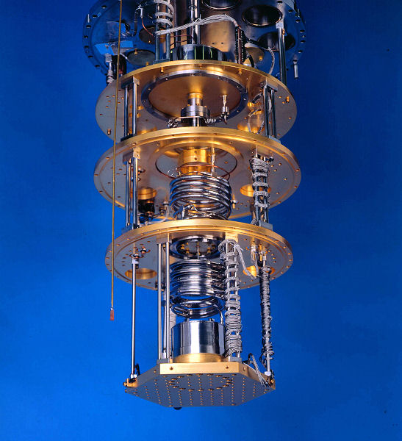
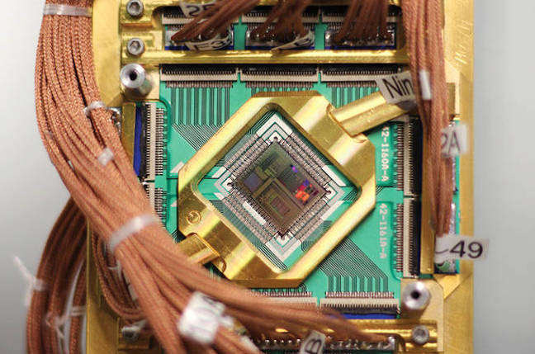
D-Wave的超导“量子”计算机

Slide 6
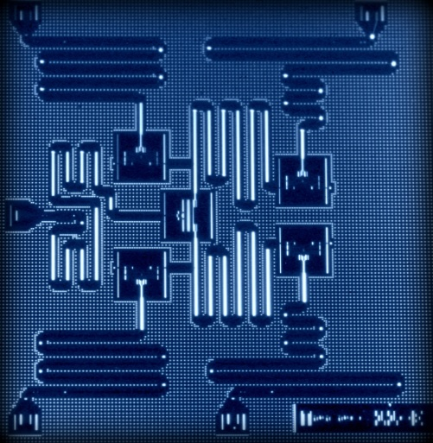
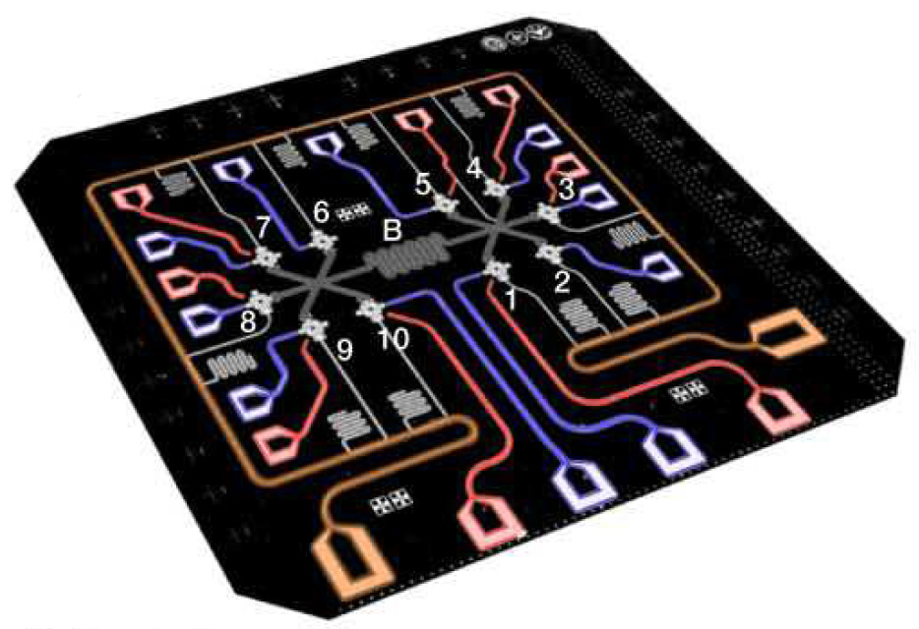
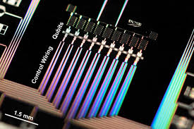
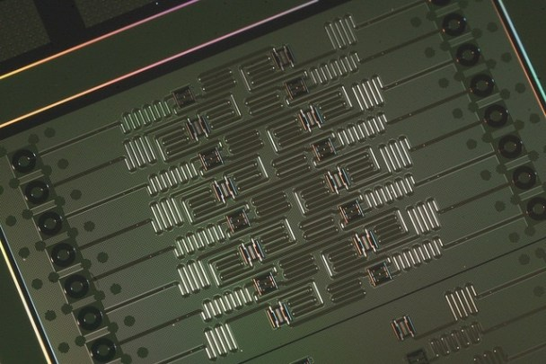
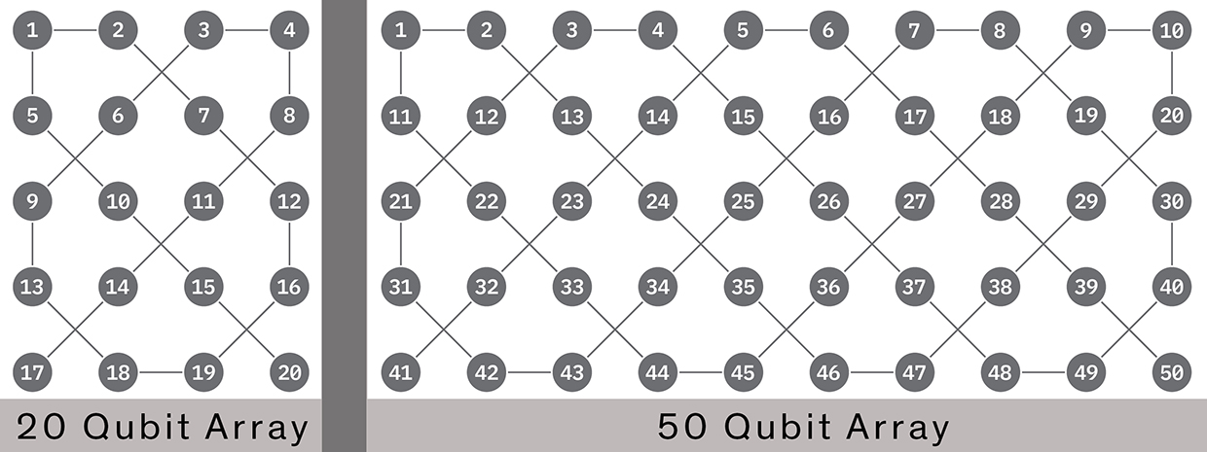
超导量子计算进展
5比特量子芯片
IBM（2016）
9比特量子芯片
谷歌（2015）
10比特量子芯片
浙大-中科大（2017）
17比特量子芯片，Intel（2017）
20及50比特量子芯片，IBM（2017）

Slide 7
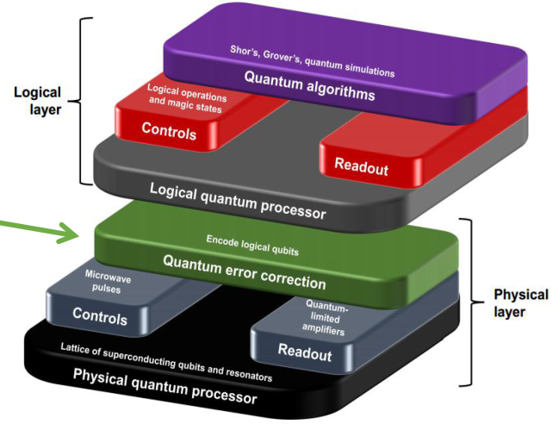
量子计算早期 可能的应用
超导量子计算与量子模拟
量子模拟
量子优化
量子采样
现阶段

Slide 8

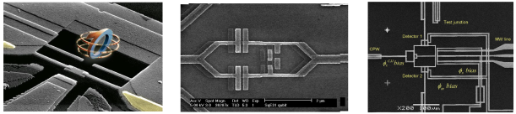
超导量子计算与量子模拟
量子力学
基本问题
薛定谔猫
贝尔不等式
原子物理
ATS、EIT、CPT、STIRAP
量子光学
Stark、Lamb
耦合量子系统
量子声学、cQED、光力耦合、自旋-量子比特
量子热力学
量子热机、
麦克斯韦妖
量子模拟
凝聚态物理、量子化学、天体物理、宇宙学、量子场论

Slide 9
不同的量子体系
micro
PHOTONS
NUCLEAR /ELECTRON SPINS
IONS
ATOMS
MOLECULES
QUANTUM DOTS
SUPERCONDUCTING CIRCUITS
Circuits are quantized!!
coupling
With envriment
MACRO
-engineered Hamiltonian with: capacitors, inductors and Josephson junctions A. J. Leggett. 1982
-First demonstration by Devoret, Martinis, Clarke (1985)

Slide 10
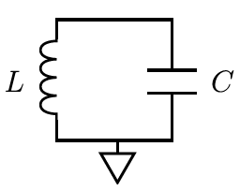
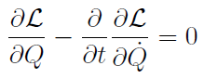
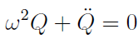
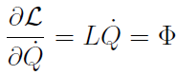
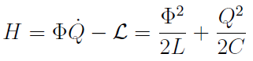
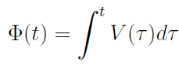
LC circuit
上述推导中，将Q看成坐标，Φ看成动量。反过来将Q看成动量，Φ看成坐标也可以，而且后面会看到，这种选择更方便。
从电路知识可以得到：
所以上面的Φ也可以看成是电感上电压对时间的积分：

Slide 11
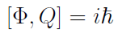
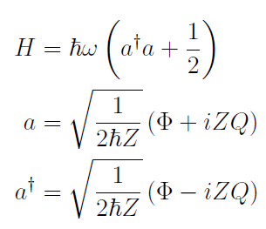
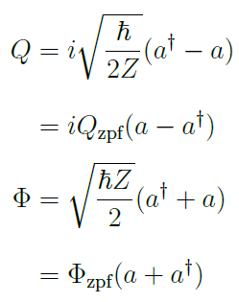
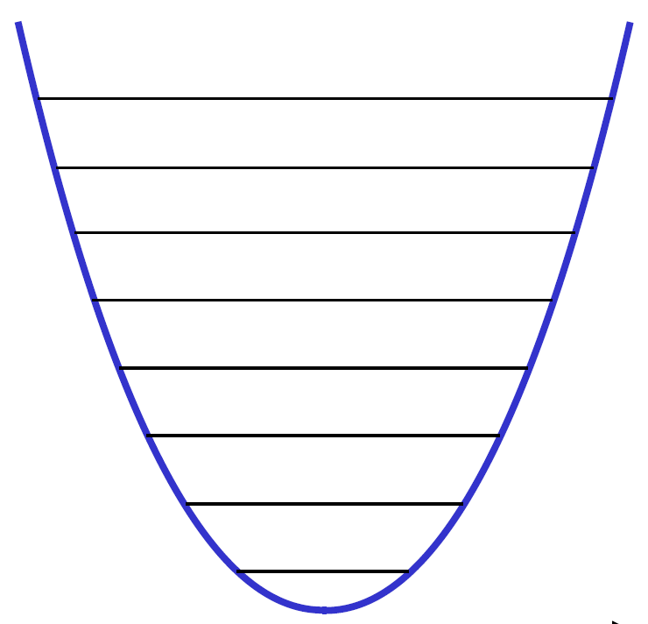
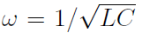
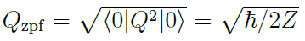
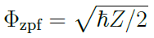
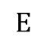


LC circuit: quantization
LC电路就是一个标准的谐振子电路。利用标准的正则量子化方法：
可以证明上述哈密顿量将具有下述形式：
$$E$$
$$ℏω_{}$$
$$φ$$
是电路的特征阻抗。
Q_{zpf}和Φ_{zpf}是基态的电荷数和磁通涨落。对于任意的|n>态：

Slide 12
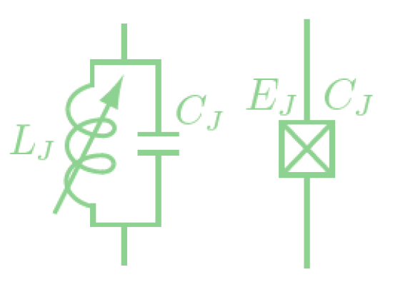
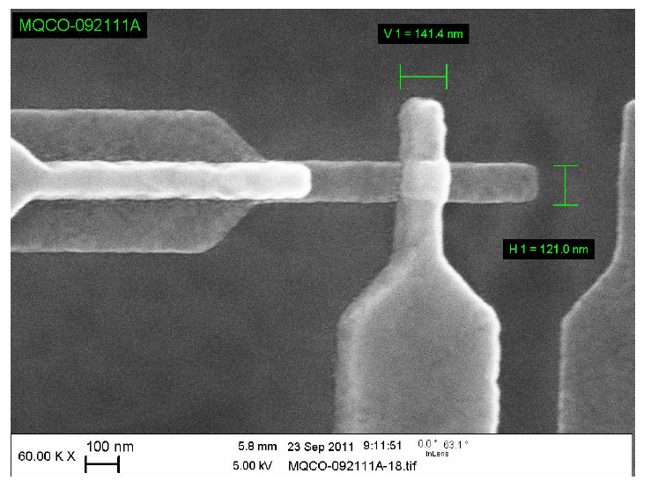

Josephson Junction
LC电路量子化之后是一个量子谐振子，其本征能级都是等间距分布的，因此不适合作为量子比特。为了获得一个具有非等间距能级分布的量子体系，我们需要一个非线性的电路元件。超导约瑟夫森结正好满足这个要求。
SC
$$E$$
~1nm
SC
$$ℏω_{r}$$
$$φ$$

Slide 13
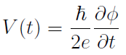
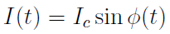
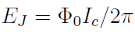
Josephson Junction
超导约瑟夫森结满足下述关系式：
φ是约瑟夫森结两端的超导相位差，I_{C}是结的临界电流。
结合上面两个式子，我们得到：
所以，约瑟夫森结可以看成一个非线性电感L(φ)。但另一方面，约瑟夫森结的结构决定了它又是一个电容，所以总体来说，它可以视为一个电容并联了一个非线性电感。
对于一个普通线性电感，当有电流流过时，它积累的磁场能量为：
但对于约瑟夫森结这样一个非线性电感，L不是常数，所以结果不一样：
这里定义了一个重要的关于约瑟夫森结的参数，约瑟夫森能量：
其中Φ₀=h/2e=2.07 x 10⁻¹⁵ Wb是磁通量子。

Slide 14
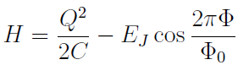
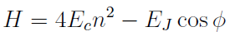
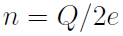
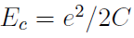
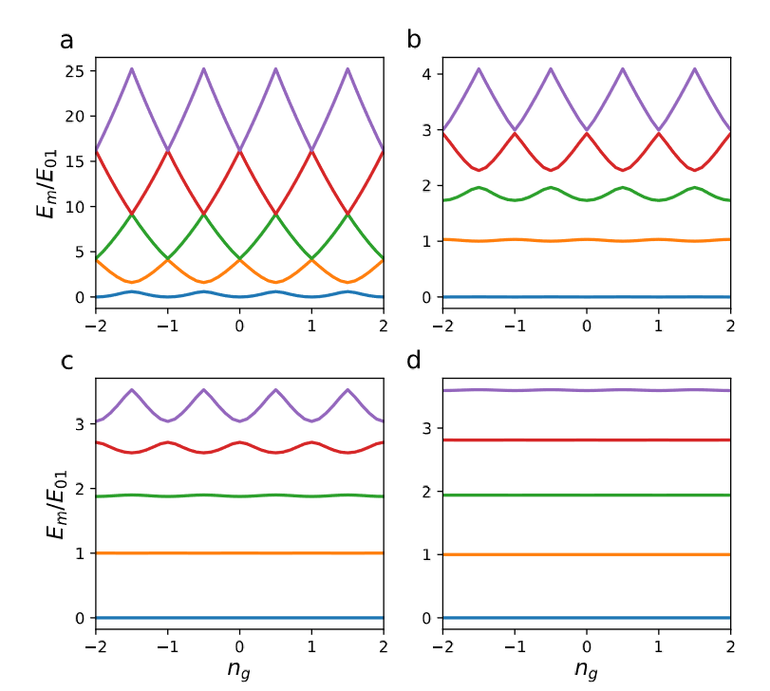
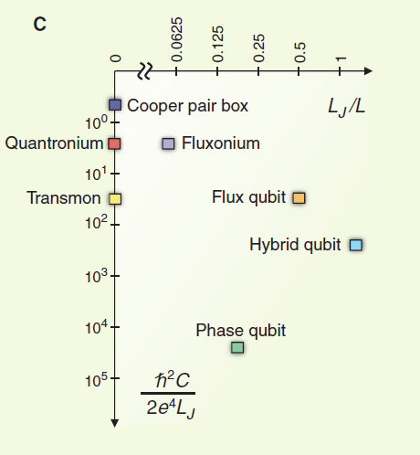
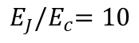
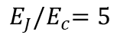
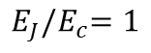
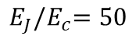
Josephson Junction
所以，一个约瑟夫森结的哈密顿量可以写成：
通常把上述哈密顿量写成这种形式：
n代表了库伯对数目，E_{C}表征了特征充电能量（4E_{C}是在C上充入一对库伯对所要的能量）。
$$E_{J}{/E}_{c}=1$$
$$E_{J}{/E}_{c}=5$$
$$E_{J}{/E}_{c}=10$$
$$E_{J}{/E}_{c}=50$$
“Transmon’ regime

Slide 15
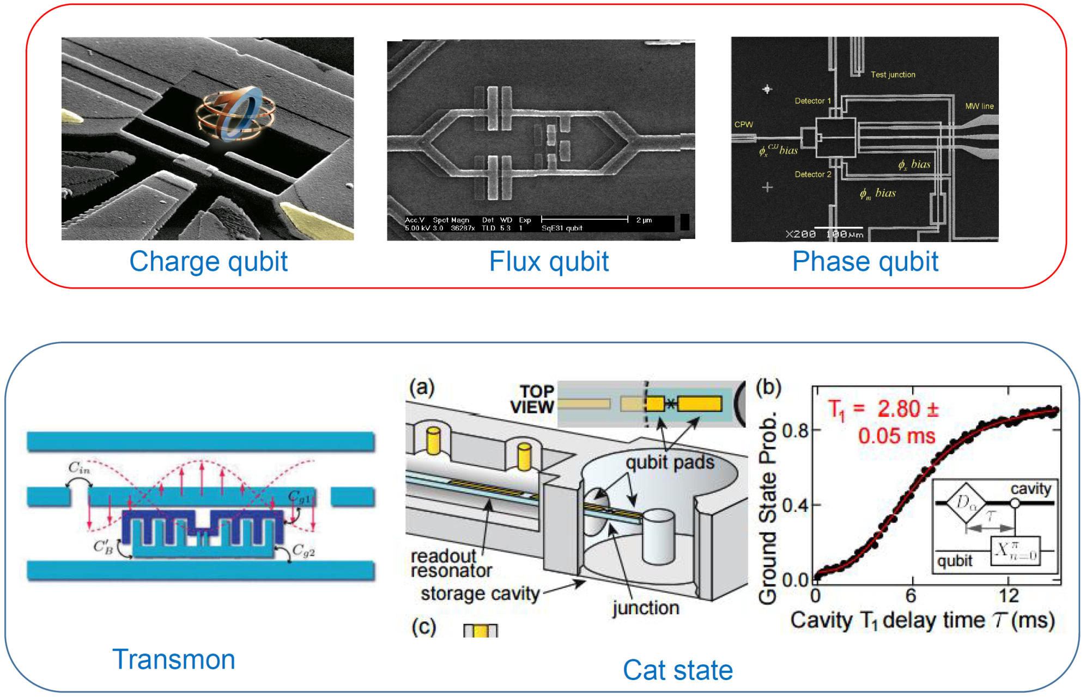
Superconducting qubits

Slide 16
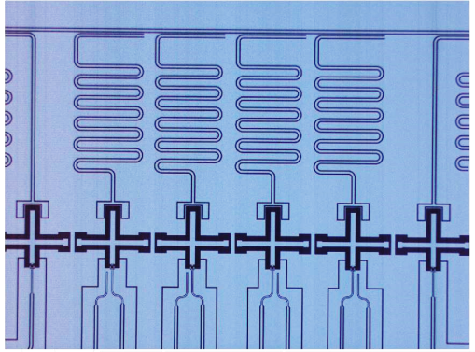





Transmon(Xmon) qubit
Jaynes-Cummings Hamiltonian
I_{Z}

Slide 17
Z and zero point fluctuation
不同类型的超导量子比特有不同的特征阻抗。
Phase qubit一般都使用大的约瑟夫森结，所以C很大，另外非线性电感的大小是反比于结的临界电流，也就是反比于结面积的，所以Z是反比于结面积的。也就是说phase qubit的Z很小，phase的涨落很小，电荷涨落很大。
Charge qubit (Cooper pair box)使用很小的结，所以和phase qubit相反，Z很大，电荷涨落很小（一般都处于电荷数的本征态），相位涨落很大。但是，尽管电荷涨落很小，由于体系的能量主要由电荷充电能Q²/2C决定，所以即使很小的涨落也会导致体系能量较大的变化。所以CPB一般对于环境中的电荷涨落特别敏感。
transmon qubit处于二者之间。它使用一个旁路大电容，结的L还是比较大，但由于旁路电容大了，所以Z还是减小了不少。我们使用的样品一般在300 Ohm左右，对应的电荷零点涨落Q_{zpf}为2.5e，相位零点涨落Φ_{zpf}为0.06Φ₀。

Slide 18


Transmon(Xmon) qubit
上述哈密顿量已经不再是一个标准的二次型，当φ足够小时可以用微扰展开：
如果只保留到φ²近似，则约瑟夫森结可视为一个简谐振子（忽略一个常数项）：
这个结果和前面得到的非线性电感结果一致：
对该简谐振子进行正则量子化：
考虑4阶修正：

Slide 19






Transmon(Xmon) qubit
把这项修正考虑进来计算间谐振子第m个能级的能量修正：
定性来说，cosφ相对于简谐振子势能开口大，所以和谐振子能级比，cosφ势能的能级都会往下落一点。E_{C}正好等于E₀₁和E₁₂的差距，表征了体系的非谐性大小。

Slide 20






Transmon(Xmon) qubit
Z
$$\frac{λ}{4} \text{R}\text{esonator}$$
XY
z
y
Readout
x

Slide 21






Experimental setup

Slide 22


Experimental setup

Slide 23
Quantum gates
z
Dynamical gates
Geometric gates
y
x
For cyclic evolution:
Berry phase
M. V. Berry, Proc. Soc. London, Ser. A 392, 45 (1984).
non-adiabatic geometric phase
Y. Aharonov and J. Anandan, Phys. Rev. Lett. 58, 1593 (1987).
non-cyclic geometric phase
NOT：
J. Samuel and R. Bhandari, Phys. Rev. Lett. 60, 2339 (1988).
non-Abelian geometric phase
Hadamard：
F. Wilczek and A. Zee, Phys. Rev. Lett. 52, 2111 (1984).
non-adiabatic non-Abelian geometric phase
J. Anandan, Phys. Lett. A 133, 171 (1988).
Notes:
The Hilbert space of a single qubit can be represented by a Bloch sphere, and single qubit quantum gates are basically unitary operations that rotate the state vector on the sphere. Such rotations are defined by the orientation angles of the rotation axis, including theta and phi, together with the angle gamma that represents the amount of rotation. For example, a quantum NOT gate can be expressed as a rotation of pi along the x-axis, and a Hadarma gate is simply a rotation of 90 degrees around the y-axis, which transforms the state zero into an equally weighted superposition of the states zero and one. On the other hand, quantum gate operations can be also viewed as specific manipulations of the relative phase between the states zero and one. In this regard, there are two different ways of realizing quantum gates: dynamical gates and geometric gates. For the dynamical gates, the relative phase between zero and one is varied via the dynamical evolution of the Hamiltonian of the qubit. This is the more familiar way of realizing quantum gates. For the geometric gate, it utilizes the fact that when the system’s Hamiltonian evolves in some parametric space, its eigenstates can acquire geometric phases. For example, if the Hamiltonian contains some time-dependent parameter R(t), if R(t) is varied adiabatically, the eigenstates and corresponding eigenenergies of the Hamiltonian also evolve adiabatically. For a cyclic evolution, the eigenstates will return to their original form, but up to a phase factor. Such a phase contains both dynamical and geometric contributions. Geometric quantum gates are based on manipulation of such geometric phases. The concept of geometric phase was first proposed by Michael berry, for adiabatic and cyclic evolutions as just discussed, and was later extended to non-adiabatic, non-cyclic, non-Abelian scenarios, as well as their various combinations.

Slide 24






Geometric quantum computation
 | adiabatic | non-adiabatic
Abelian
non-Abelian
adiabatic Abelian GQC^{[1]}
non-adiabatic Abelian GQC^{[2,3]}
adiabatic holonomic QC^{[4]}
non-adiabatic holonomic QC ^{[5,6]}
[1] J. A. Jones et al., Nature 403, 869 (2000). [2] Wang X.-B. and M. Keiji, Phys. Rev. Lett. 87, 097901 (2001).
[3] S.-L. Zhu and Z. D. Wang, Phys. Rev. Lett. 89, 097902 (2002). [4] L. M. Duan et al., Science 292, 1695 (2001).
[5] E. Sjöqvist et al., New J. Phys. 14, 103035 (2012). [6] G. F. Xu et al., Phys. Rev. Lett. 109, 170501(2012).
Experiments of non-adiabatic holonomic quantum computation (NHQC)
NMR, 2013
Transmon, 2013
NV, 2014
NV, 2014
NV, 2017
Transmon, 2018
Notes:
These different combinations can be used to implement different types of geometric quantum computation. For example, if the system under study consists more then two energy levels, then after some evolution, the acquired geometric phases may not be simple numbers, but rather a matrix. This can be utilized to realize the so called non-Abelian geometric quantum computation. Researchers give this type of geometric quantum computation a specific name: holonomic quantum computation, or HQC, emphasizing its connection to the mathematical concept of holonomy. Holonomic quantum computation can be further divided into adiabatic and non-adiabatic HQC, depending on the nature of the corresponding evolution. Non-adiabatic holonomic quantum computation was initially proposed to overcome the shortcoming of long runtime associated with the adiabatic HQC proposals. In these proposals, in order to satisfy the adiabatic condition, evolutions must be kept slow enough to avoid unwanted transitions among the instantaneous eigenstates of the system’s Hamiltonian. However, since the decoherence time is always finite, slow evolutions are not desirable for quantum gate operations. Researchers have proposed a variety of non-adiabatic HQC schemes. Here I listed a few representative experimental work related to non-adiabatic HQC. They were done on different platforms, including NMR, NV centers in diamonds, and superconducting qubits.

Slide 25

NHQC and STAHQC
Some issues with NHQC
requirements: cyclic evolution, parallel transport
restrictive constraints on control Hamiltonian
incompatible with other optimization methods
S. B. Zheng, C. P. Yang, and F. Nori, Phys. Rev. A 93, 032313 (2016)
Shortcut-to-adiabaticity HQC
For cyclic evolution:
STA：
Cold atom：Y. X. Du et al., Nat. Commun. 7, 12479 (2016), M. G. Bason et al., Nat. Phys. 8, 147 (2012).
NV： J. Zhang et al., Phys. Rev. Lett. 110, 240501 (2013).
Ion tap：S. M. An et al., Nat. Commun. 7, 12999 (2016).
Robustness： B. B. Zhou et al., Nat. Phys. 13, 330 (2017), Z. Zhang et al., Phys. Rev. A 95, 042345 (2017).
STAHQC：
Z. T. Liang et al., Phys. Rev. A 93, 040305 (2016), J. Zhang et al., Sci. Rep. 5, 18414 (2015),
X. K. Song et al., New J. Phys. 18, 023001 (2016), P. V. Pyshkin et al., Sci. Rep. 6, 37781 (2016)
B.-J. Liu et al., Phys. Rev. A 95, 062308 (2017).
This work：
B.-J. Liu et al., arXiv:1806.07904 (2018), T. X. Yan et al., Phys. Rev. Lett. 122, 080501 (2019).
Notes:
While non-adiabatic HQC schemes can indeed speed up quantum gate operations, they have their own issues. For example, they usually have certain requirements, including cyclic evolution and parallel transport. These requirements together pose rather restrictive constraints on the control Hamiltonian, making the corresponding gate operations rather sensitive to control errors. In addition, these non-adiabatic HQC proposals are usually not compatible with other optimization methods. A comprehensive discussion of such constraints can be found in this paper.
Besides the non-adiabatic HQC proposals discussed above, researchers have developed other ways to overcome the long runtime issue associated with adiabatic HQC. One example is a collection of HQC schemes based on the so called shortcut to adiabaticity technique. Of course, in a broad sense, they can also be categorized as non-adiabatic HQC. However, to emphasize their difference with the more conventional non-adiabatic HQC proposals, researchers tend to treat them as a separate group by their own. The essence of these STA based HQC proposals is the following. For a time-dependent Hamiltonian H0, an auxiliary term Ha is appended, so that for a given evolution time T, the dynamics under the new Hamiltonian is equivalent to that under the original Hamiltonian H0. The specific form of Ha is case dependent and needs to be designed for individual scenarios. Note that this phase factor contain two parts, including a dynamical phase and a geometric phase. STA technique has been widely used on many different platforms to accelerate adiabatic processes. In recent years, researchers have also proposed several STA based holonomic quantum computation schemes. However, these early proposals use rather sophisticated configurations. For example, most of them require at least four energy levels. Therefore it is technically quite challenging to implement them. To address such an issue, our theoretical collaborators proposed a simplified STAHQC scheme, and we demonstrated this scheme using superconducting quantum circuits in a recent work. In the following, I will first discuss this proposal in detail, and then show you our experimental demonstration.

Slide 26


Driven three-level system
( , , , )
( , , , )
Eigenstates:
Notes:
This simplified proposal uses a three level system driven by two external control fields. The ground and the second excited states are defines as the computational basis states 0 and 1, while the first excited state is an auxiliary state. The frequencies of both external control fields are detuned from their corresponding transitions by the same amount of delta t, which may be time-dependent. In addition, the amplitudes and phases of the two signals are also time-dependent in general. For the sake of clarity, we define a new set of four parameters that are equivalent to the original set of amplitudes and phases. It can be shown that the Hamiltonian of this driven system can be written into the following form. By varying these parameters of the external control fields, we are then able to design a time-dependent Hamiltonian and obtain desired evolution. The b state, or the bright state, is a linear superposition of the states 0 and 1. In addition, there also exists a dark state, defined as this. The dark state is dynamically decoupled from the system’s evolution. In other words, the dark state is an eigenstate of H0 with the eigenenergy of zero. The other two eigenstates of H0 are denoted as E plus and E minus states, and have these forms. Next, I will show you how to realize arbitrary single-qubit gate operations in this system by carefully adjusting these control parameters.

Slide 27


Geometric phase
Consider an adiabatic cyclic evolution of H₀(t ) from t = 0 to T
Apply the following constraints:
We then have:
Elimination of dynamical phase:
Notes:
Let’s consider an adiabatic cyclic evolution of H0 from time zero to T. we are particularly interested in two of H0’s eigenstates, the dark state and the E minus state, and want to see how they evolve under the above adiabatic cyclic evolution. In addition to the cyclic condition, we further apply the following constraints, and their meaning will become clear shortly.
The dark state, by definition, is dynamically decoupled from the system’s evolution, so it remains unchanged during the whole cyclic evolution. On the other hand, for the time-dependent E minus state, as long as the adiabatic condition is satisfied, it will stay as an instantaneous eigenstate of H0 during the whole cyclic evolution. With these constrains applied, it can be easily shown that at t=0, the E minus states is the same as the bright state, at the middle of the evolution, E minus happens to be the first excited state, and at the end of the evolution, it returns to the bright state, but with an additional phase factor. This phase contains dynamical and geometric parts. Let’s first pay attention to the geometric phase. The analysis of the geometric phase becomes rather simple on a Bloch sphere whose north and south poles are the bright and the first excited states, respectively. On this sphere, with the above choice of control parameters, it can be shown that the cyclic evolution is a simple trajectory. The two halves of the trajectory correspond to two different longitudes of gamma 1 and gamma 2, respectively. Therefore the overall geometric phase is simply the solid angle spanned by this trajectory, which is gamma 2 minus gamma 1. Next, we also need to consider the dynamical phase. In our proposal, we specially design the control parameters of the external driving fields, so that the dynamical phases accumulated during the two halves of the evolution cancel each other. A simple way to achieve this, for example, is to add a pi pulse at the middle of the evolution. As a consequence, the net phase resulted after the cyclic evolution will be purely geometric.

Slide 28
Arbitrary single-qubit quantum gate with STA
In the subspace spanned by and , the above cyclic evolution
can be expressed as:
Shortcut-to-adiabaticity Hamiltonian:
Notes:
Now, in the subspace spanned by the dark and the bright states, the above cyclic evolution can be expressed as the following form. This is obvious since during the evolution the dark state does not change and the bright state acquires a geometric phase gamma.
Since the dark and the bright states are both linear superpositions of the computational basis states 0 and 1, we can then rewrite U in the computational basis as the following matrix form, which is basically a rotation along an axis with the orientation angles theta and phi, by an amount of gamma, up to an overall phase of half of gamma. Now recall that all these parameters, theta, phi, and gamma, are nothing but combinations of the amplitudes and phases of the two external driving fields. Therefore, by carefully designing our control fields, we should be able to realize arbitrary single qubit quantum gates.
Up to this point, we have been discussing adiabatic evolutions. We now apply the shortcut to adiabaticity technique by adding an auxiliary term as discussed a few slides back. In our proposal, it turns out this extra term has a rather simple form as shown here.
Next, I will show you how we experimentally realized this proposal using superconducting quantum circuits.

Slide 29





Xmon-type superconducting qubit
L(δ)
C
ω_{ge} | 5.665 GHz
ω_{ef} | 5.417 GHz
 | 29 μs
 | 9 μs
 | 5.9 μs
 | 5.8 μs
Probability
Transmission
Q
I
f (GHz)
τ (μs)
Notes:
We use the Xmon type of superconducting qubits to carry out the experiment. This is a schematic of our sample. The Xmon qubit is located here. In this zoomed in image, you can clearly see that the Xmon consists two josephson junctons. They form a squid loop. An xmon qubit is essentially a nonlinear inductor in parallel with a capacitance. The xmon qubit is actually a multi level system, but for our purpose, we only care about the lowest three levels. As we discussed before, we define the ground and the second excited states as our computational basis states, and use the first excited state as an auxiliary state. Due to the intrinsic nonlinearity, the energy difference between 0 and e states is slightly larger than the difference between the e and the 1 states. In the proximity of the squid loop, there is a bias line, which is connected to the z control line shown here. By tuning the current flowing on this line, we can fine tune the magnetic flux in the squid, thus fine tune the energy differences among these states. This cross are capacitances that can couple the xmon to external circuits as well as neighboring qubits. The external driving fields are applied via the xy control line here. In our case, they are microwave pulses with variable amplitudes and phases. In addition to these control lines, the xmon is capacitively coupled to a quarter lamda resonator, which is in turn coupled to a transmission line. The resonator and the transmission line together form our readout circuit. In the so called dispersive regime, the transmission coefficient of the transmission line is very sensitive to the qubit state. For example, as this figure shows, when the qubit is in its ground state, the transmission curve is this blue curve, and it shifts to the red curve when the qubit is excited to the 1 state. By measuring the transmission, we can perform non demolition measurements of the qubit state. We carefully characterize our qubits using standard procedures, for example, the Ramsey fringe for measuring the dephasing time T2. This table summarizes some important parameters. The transition frequencies among the states, T1 for the first and second excited states are 29 and 9 micro seconds respectively, and their dephasing times are around 6 micro seconds.

Slide 30


Dark and bright states
( , , , )
( , , , )
Notes:
With the capability of controlling the qubit and measuring its state, we can now implement the theoretical proposal discussed before. To refresh your memory, we use two external microwave pulses with variable amplitudes and phases to control our qubit. This table gives the details of the two driving fields used in our experiment. With such choices, we are able to eliminate dynamical phases accumulated during a cyclic evolution and obtain a pure geometric phase, and realize arbitrary single qubit rotation.
As an initial step, we first verify that the bright and the darks state evolve as expected. If we set both theta and phi to zero, the 0 state happens to be the dark state, and the corresponding rotation is around the z axis by a pi angle. Figure a shows the result. The horizontal axis represents the evolution time, and the vertical axis is the population of the three energy levels. During the whole evolution, the population of the three levels do not change, as it should be for a dark state. Now if we set theta to be pi, phi to be zero, then the 0 state happens to be the bright state, and the corresponding rotation is around the minus z axis by a pi angle. During such an evolution, the 1 state doesn’t get populated, while the population of the 0 and the first excited states swap twice. In both figures, the lines represent theoretical results, and symbols are experimental data. We can see they agree with each other very well.

Slide 31

Arbitrary single-qubit quantum gate
Notes:
Next, we verify that we can achieve arbitrary single qubit quantum gate. Here we show three representative cases. In the first case, we vary the theta angle from zero to pi, fix phi to zero and gamma to pi. This choice means that the rotation axis is always in the xz plane on the Bloch sphere. Again, we monitor the change in the population of the three energy levels. In the second case, we set both theta and gamma to be half of pi, and vary the phi angle from zero to two pi, so now the rotation axis is in the xy plane of the Bloch sphere. In the last case, we set theta to be half of pi, phi to zero, and change gamma from zero to 2 pi, this means a rotation around the x axis by a variable angle. In all three cases, the experiment data agree with the theoretical predictions very well.

Slide 32






Fidelity of single-qubit gate
preparation
gate
QST rotation
Factors that reduce fidelity
Dynamical contribution of higher levels
Probability
Probability
time (ns)
time (ns)
Decoherence
Errors in control signals
Gate | Fidelity (exp.) | Fidelity (th.)
X | 96.6 ± 0.8% | 98.4%
H | 97.6 ± 1.0% | 98.4%
X(π/2) | 96.4 ± 1.0% | 97.8%
Notes:
Next, we determine the fidelity of our single qubit quantum gates. We use the quantum process tomography to reconstruct the density matrix of quantum states, and extract fidelity information from these matrices. Figure a here shows that procedure of quantum process tomo. Since using our proposal we are able to generate arbitrary single qubit rotations, we use our method in all three stages of the tomo process, namely, the state preparation, the quantum gate operation, and the final rotation for quantum state tomo measurement. Figure b to e show the results for three representative quantum gates. Here the colored columns are experimental data and the outer frames are simulations results. They agree with each other rather well. Numerical values are summarized in this table.
We also analyzed the factors that might reduce gate fidelity. They include, for example, dynamical contribution of higher levels, decoherence, and errors in control signals. In the discussion of our proposal, we only considered three energy levels. However, an Xmon qubit is a multi level system, and the higher levels may affect system’s dynamics. For example, in this figure, we show the simulation of density matrix elements during a not gate, with and without the dynamical contribution from the higher levels. It is obvious that when these higher levels are taken into account, we obtain these extra oscillation features. They surely limit the highest fidelity that can be realized on this gate. The second factor is decoherence, which can be simulated using a master equation approach. The third factor is errors in the control signals. This figure shows the performance of a not gate as a function of the control error alpha for several different HQC proposals. Overall speaking, our STAHQC scheme delivers better results when control errors are present.

Slide 33
量子计算早期可能的应用
超导量子计算和量子模拟
量子力学
基本问题
薛定谔猫
贝尔不等式
原子物理
ATS、EIT、CPT、STIRAP
量子光学
Stark、Lamb
现阶段
耦合量子系统
量子声学、cQED、光力耦合、
自旋-量子比特
量子热力学
量子热机、
麦克斯韦妖
量子模拟
凝聚态物理、量子化学、天体物理、宇宙学、量子场论
量子模拟
量子优化
量子采样

Slide 34










量子模拟
Heisenberg模型
量子模拟：
Hubbard模型
待模拟体系
（不可控）
拓扑序
量子化学
量子模拟器
（可控）
初始态制备
末态测量
量子场论
天体物理

Slide 35






量子模拟：Dirac Hamiltonian
1D Dirac Hamiltonian

Slide 36


量子模拟：Graphene

Slide 37






量子模拟：Kitaev chain

Slide 38



Welcome to the Future

